Slide 1

Simulation of Emergency Rooms

Slide 2
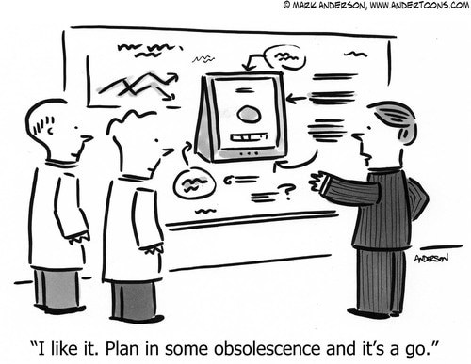
Road Map
Background
An explanation as to why the ER is not just for emergencies
Simplifying Assumptions
Data
Sources and Cleaning
Molding Data Based on Assumptions
Simulation
Base Model
Definitions
Additional Work
UK Model - Splitting ER into Urgent Care Center and Accident/Emergency Center
Is this a way forward for the US?

Slide 3

Background - Insurance and Healthcare in US
“Standard” Health Insurance
“Low” Annual Deductible
Primary Care Physician
Routine Check-Ups
Implications for ERs:
People in this category use ERs for Emergencies or after hours
Catastrophic or No Health Insurance
High Deductible
No Primary Care Physician
No Routine Check-Ups
Implications for ERs:
Many people in this category may visit ERs since they don’t have primary physicians
Obviously, these are GENERALITIES. The point is that ERs handle a SIGNIFICANT level of non-Emergencies and are regarded as a stop gap for medical care. Insurance, or lack thereof, is just one reason for non-emergency ER use.

Slide 4


Additional Background - Broad Assumptions
All patients who enter the ER, will be seen by a doctor, if they so choose
Patients are triaged according to criticality, and prioritized accordingly
Patients must be assigned a room before being assessed
ER patients are either transferred, discharged, or pass away
ER Doctors have the power to treat or transfer (we do not incorporate add’l specialists into our model) all ages (no pediatric/geriatric specialization)
Administrative matters, (paperwork, sterilization of rooms after use, patient transport, etc) handled by support staff, are not accounted for in our model
Though our model does not factor in cost (of a doctor compared to a nurse), we assume that doctors cost more, hence the lesser availability

Slide 5
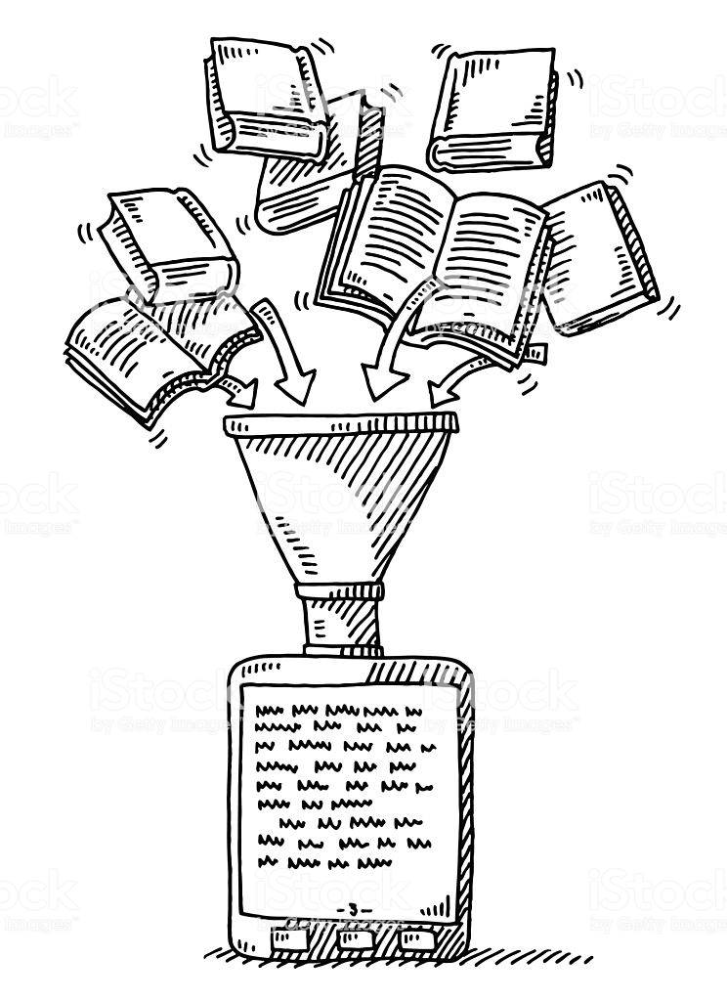
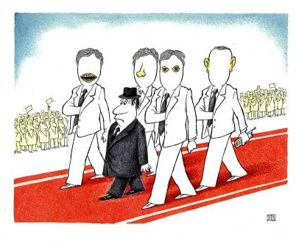
Input Data - ER Arrival Rates
Arrival Rates
Data from 1 year of data at a specific ER (per hour rates)
model study (USING SIMPLIFIED DISCRETE-EVENT SIMULATION MODELS FOR HEALTH CARE APPLICATIONS by Virtue, Kelly, Chausselet).
We then split the arrival times (83% Front Door, 17% by Ambulance)
https://www.acepnow.com/article/emergency-medical-services-arrivals-admission-rates-emergency-department-analyzed/
Normal distribution around these averages (Mean/Standard Deviation calculated in Excel)

Slide 6

Input Data - Criticality of Patients
Criticality of patients
Difficult to find data here
Iranian Study sorts out ER arrivals (by %) into 5 categories (1 being most critical). We used this to apply percentages to 3 categories (critical, urgent, non-urgent) - https://www.ncbi.nlm.nih.gov/pmc/articles/PMC4437092/
Ambulance arrivals are about 3 times as likely to be critical/urgent than front door arrivals - https://www.acepnow.com/article/emergency-medical-services-arrivals-admission-rates-emergency-department-analyzed/

Slide 7
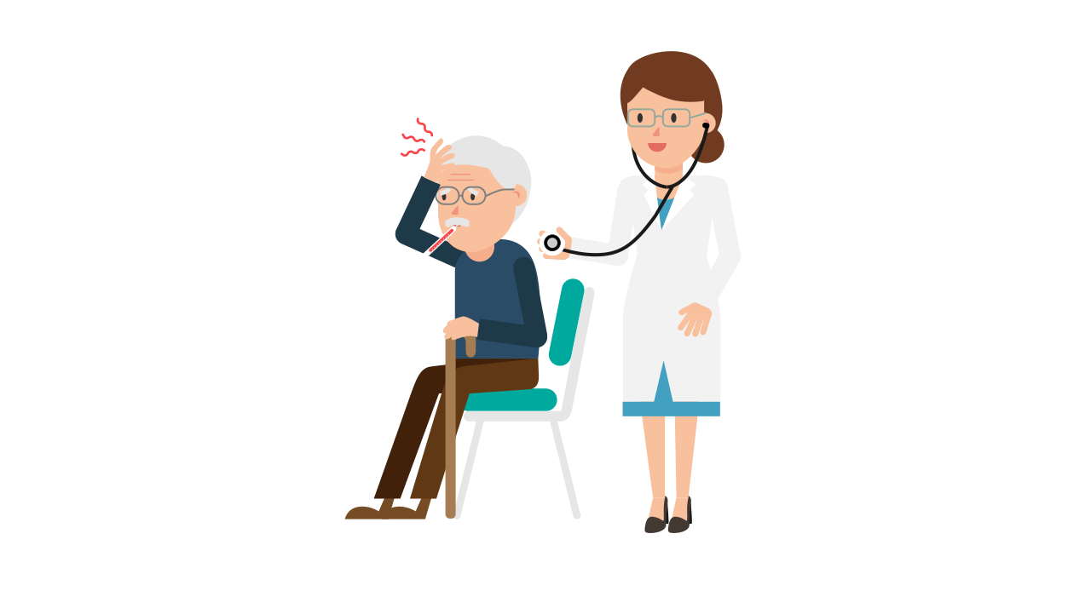
Input Data - Treatment Times
Patient Processing/ Treatment Times
Time spent by nurses for preparation before seeing the doctor
Critical: 2*(BETA(10,10) + TRIA(3,4,5))
Urgent : (BETA(10,10) + TRIA(3,4,5))
Non-urgent: (BETA(10,10) + TRIA(3,4,5))
Time spent by doctors to operate different categories of patients
Critical: TRIA(20,30,60)
Urgent: TRIA(15,20,40)
Non Urgent: TRIA(8,10,20)
Time taken to discharge the patient from the ER and move to the next location and then clean up the room
Same for all: TRIA(8,10,12)
The numbers on the paper didn’t seem very realistic, so we retained the distributions and changed the most likely, minimum and maximum values to make the data more suited for our study.
All times are indicated in minutes
https://www.ncbi.nlm.nih.gov/pmc/articles/PMC3664080/

Slide 8
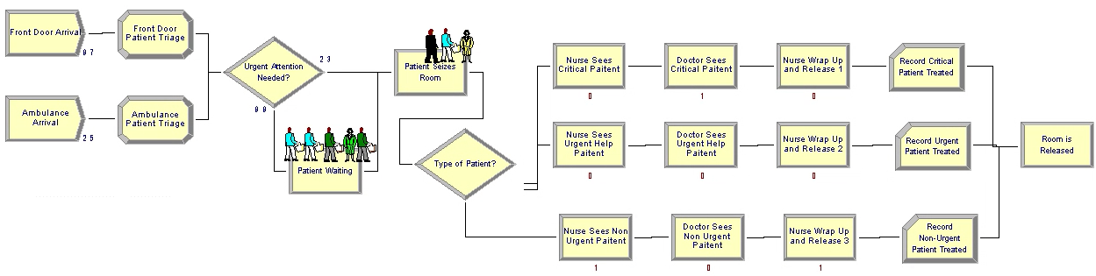
Base Model
Entities : Patients
Resources : Rooms, Nurses, Doctors
Variables : No. of rooms, no. of doctors, no. of nurses
Queues : Non-Critical Patient Waiting Queue, Room Seize queue, Nurse Seize Queue, Doctor Seize Queue
Statistical Accumulators : No. of Critical Patients Treated, No. of Urgent Patients Treated, No. of Non- Urgent Patients Treated, Patient Waiting Times

Slide 9
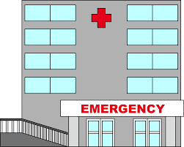
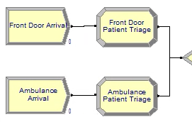

Base Model - Arrival and Triage
Ambulance Arrivals have higher rate of criticality
Patient Index
Critical/Life-Threatening
Resuscitation, Heart Attack, Stroke, Unconsciousness, etc
Critical/Non-Life-Threatening
Broken bones, etc
Non-Critical/Non-Life-Threatening - could be treated by a primary care physician or NP
Common cold, strep throat

Slide 10
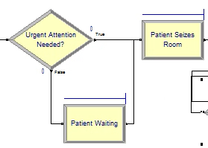
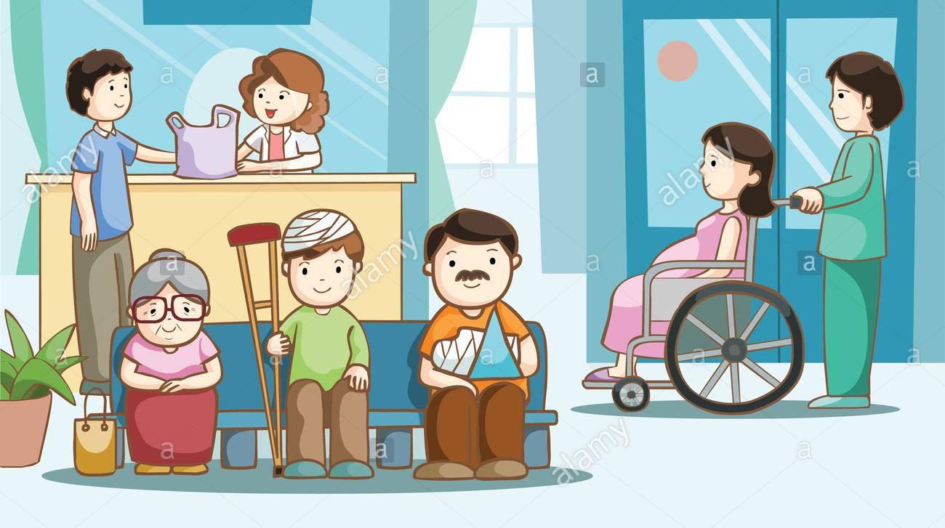
Base Model - Room Assignment
Our Hospital has 6 ER rooms
If the Patient is Critical, assign room immediately, else the patient waits. (‘Urgent Attention Needed?’ decide module checks criticality)
The patient is held back till one of the rooms is empty and there is no critical patient waiting for a room.
The ‘Patient Waiting’ Hold module checks for condition (NQ(Patient Seizes Room. Queue)==0) before assigning a non-critical patient a room.

Slide 11
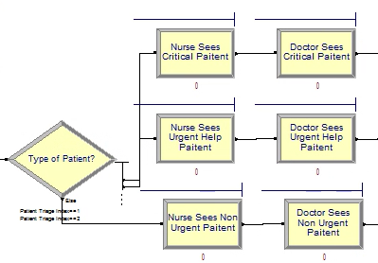

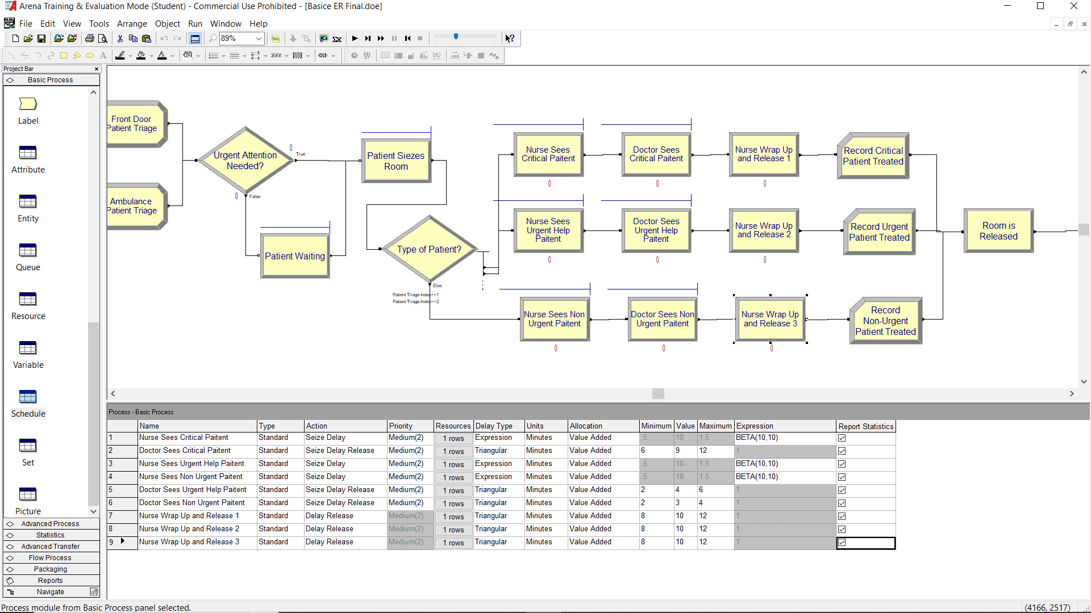
Base Model - Nurse Seize/Delay & Doctor Processes
Nurses assigned to the patients based on the Patient Triage.
Nurses first prepares patient for treatment
The doctor then treats the patient (Treatment time depends on Patient Criticality)
Fewer doctors than nurses (3 vs 5)

Slide 12

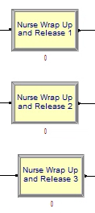
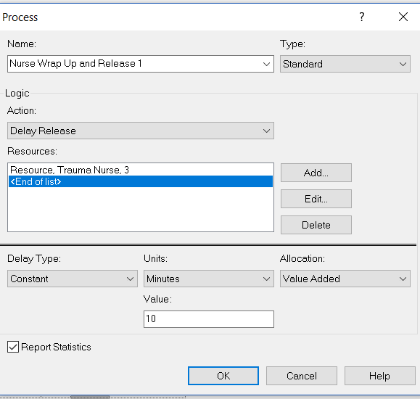
Base Model - Nurse Delay and Release
Additional delay for nurse to “out process” patient
Following this, the nurse gets released

Slide 13
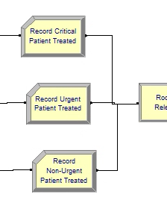
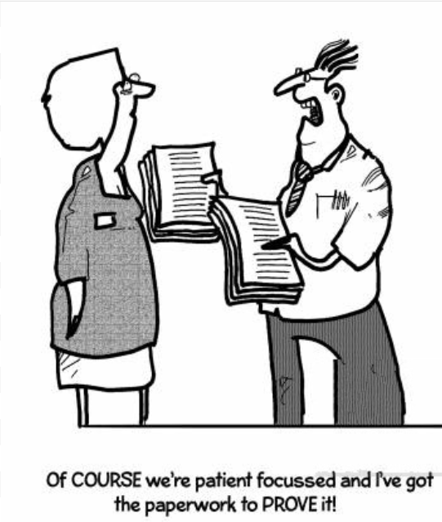
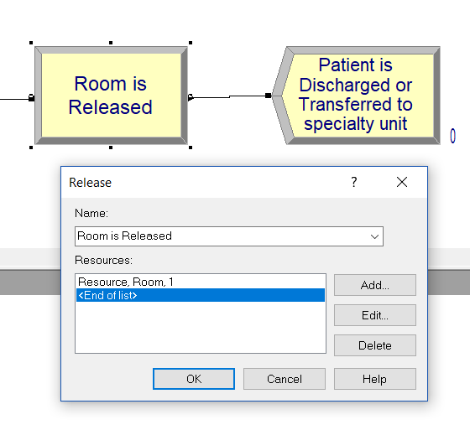
Base Model- Record Patients, Release and
Dispose
Once the patients are treated, a record module counts the number of patients treated, for each type.
After the patient’s treatment has been recorded, the room is then released and the patient entity is disposed from the system.

Slide 14
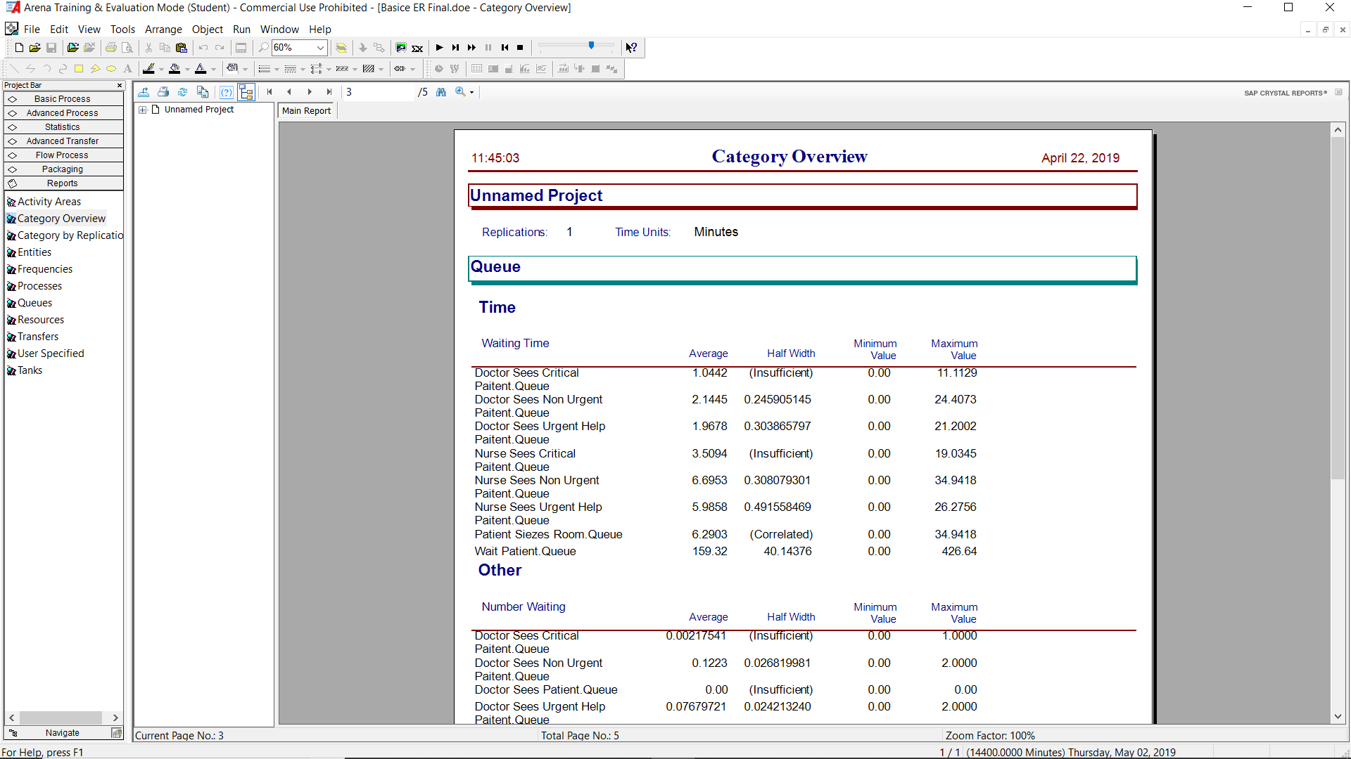
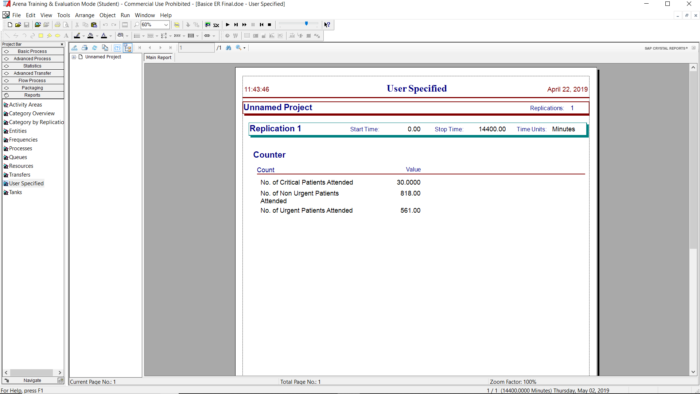
Results from 10-Day Simulation
10 day simulation with 6 rooms, 5 nurses and 3 doctors
Comparison with real life study (which says that the average stay in a US ER is 3.7 hours) - https://medicalconnectivity.com/2006/06/01/average-length-of-stay-in-eds-nationwide-too-long/

Slide 15


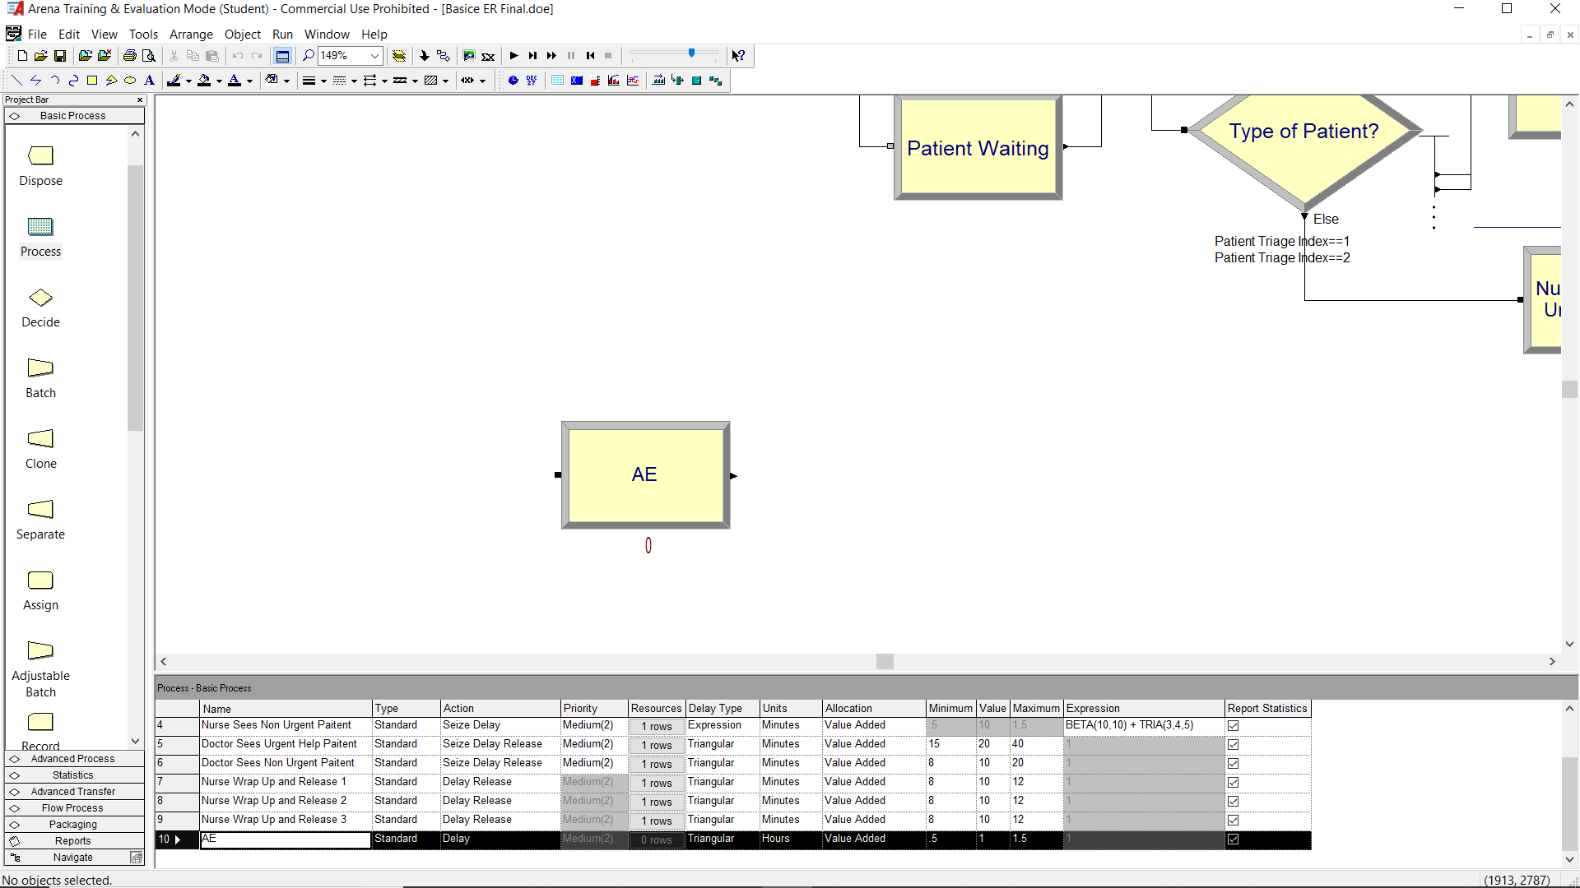

Future Work
UK ERs have been reconstructed into two sections, A&E and UCC
Implement model that incorporates UCC
Goal: Test whether efficiency is gained by implementing such a model
Implementing this model might lead to the following-
Getting rid of Hold module
Shorter wait times
Ideally, no wait for critical patients
Less critical patients can avoid being pushed to the back of queue
Efficient use of resources
Resource utilization leading to saving money - nurse practitioner instead of MD

Slide 16
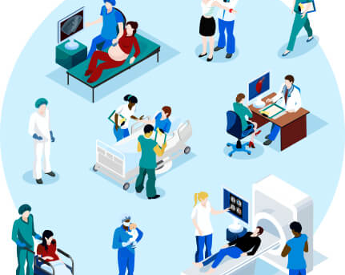

Thank You!
The Gents

